Slide 1
ALJABAR LOGIKA
KARNOUGH MAP

Slide 2
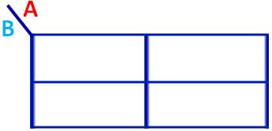
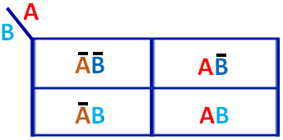
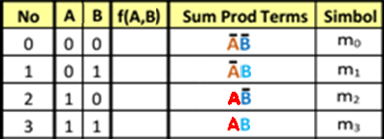
K-MAP 2 Variabel
A
A
B
B
0 0
0 1
0 1
1 1

Slide 3
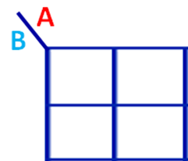
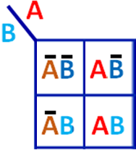
K-MAP 2 Variabel
1
0
0
1
0
1
0
0
0
1
1
1
1
0
1
0
1
1
1
0
0
1
1
0

Slide 4
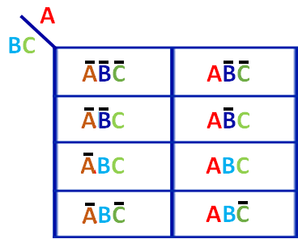
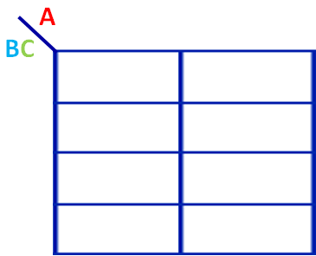
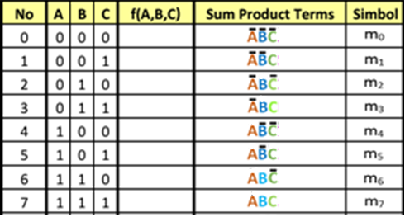
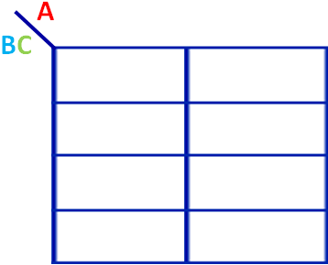
K-MAP 3 Variabel
0 0 0
0 1 1
0 0 1
1 0 1
0 1 1
1 1 1
0 1 0
1 1 0

Slide 5
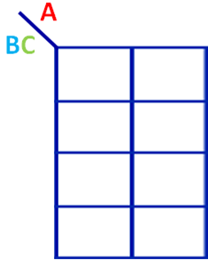
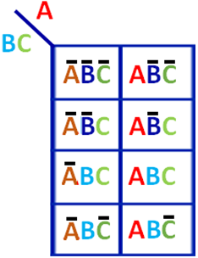
K-MAP 3 Variabel
0
1
0
1
1
1
1
0
1
1
0
1
1
0
0
1
1
1
0
1
0
0
0
0
0
1
1
1
1
1
0
1
0
1
1
1
1
0
1
1
1
0
1
0
0
0
1
1

Slide 6
TRUTH TABLE 3 Variabel

Slide 7
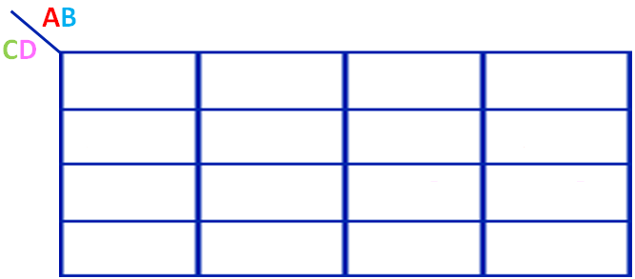
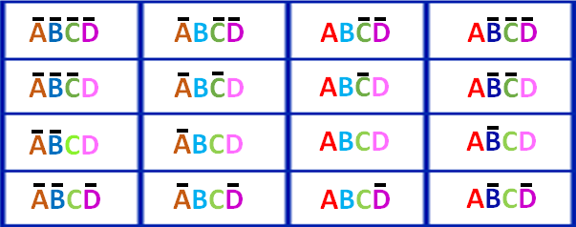
K-MAP 4 Variabel

Slide 8
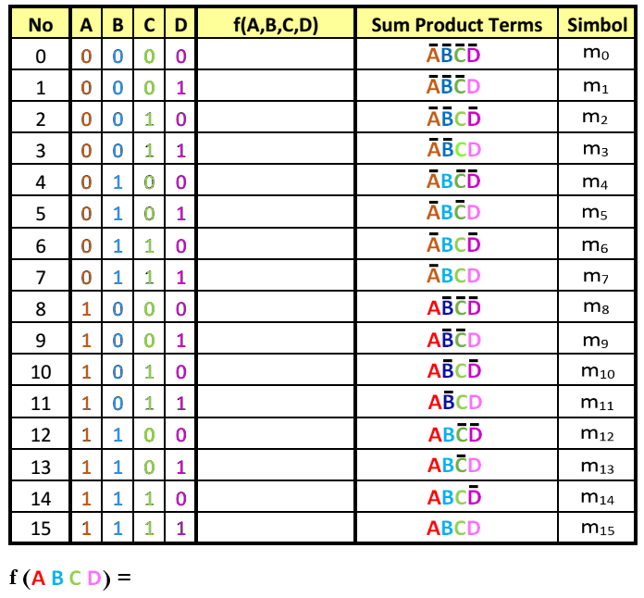
TRUTH TABLE - 4 Variabel

Slide 9
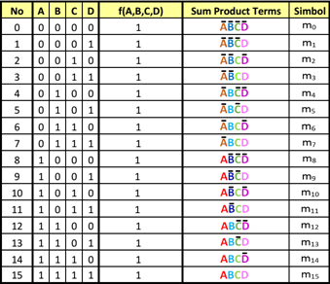








TRUTH TABLE - 4 Variabel
f (A,B,C,D)
=
+
+
+
+
+
+
+
+
+
+
+
+
+
+
+

Slide 10
K-MAP 2 Variabel
1
0
0
1
0
1
0
0
0
1
1
1
1
0
1
0
1
1
1
0
0
1
1
0

Slide 11
K-MAP 3 Variabel
0 0 0
0 1 1
0 0 1
1 0 1
0 1 1
1 1 1
0 1 0
1 1 0

Slide 12
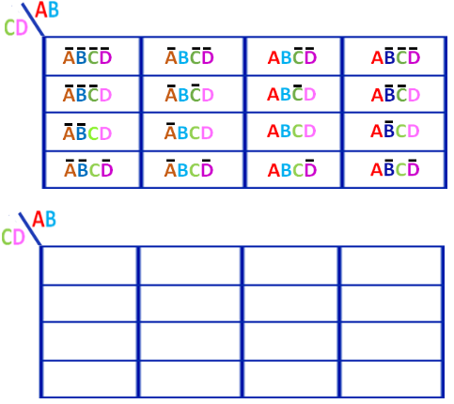
K-MAP 4 Variabel

Slide 13
CIRCUIT LOGIKA

Slide 14
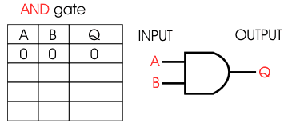
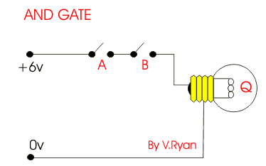
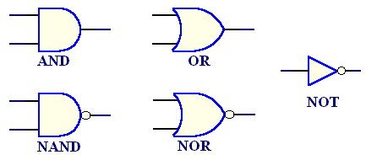
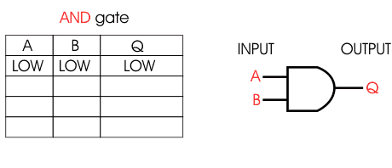
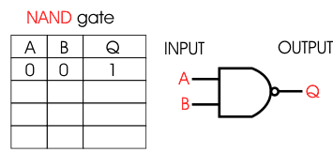

BASIC LOGIC GATE

Slide 15
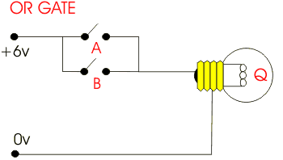
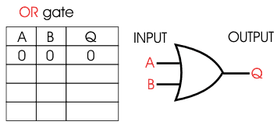
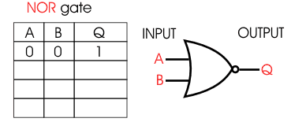

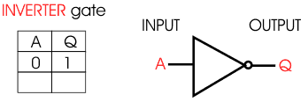

BASIC LOGIC GATE

Slide 16
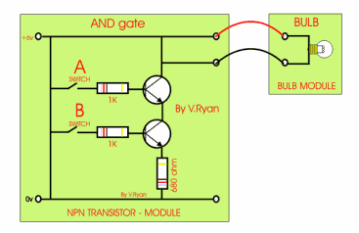
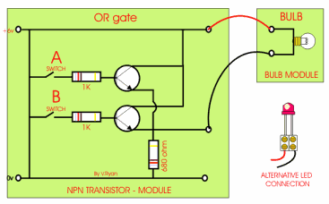
BASIC LOGIC GATE

Slide 17












BASIC LOGIC GATE 2, 3 dan 4 INPUT

Slide 19


Slide 20
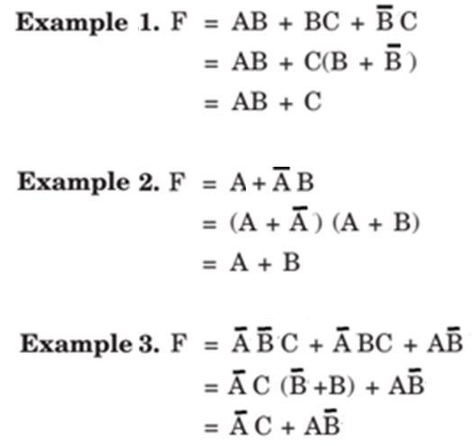

Slide 21
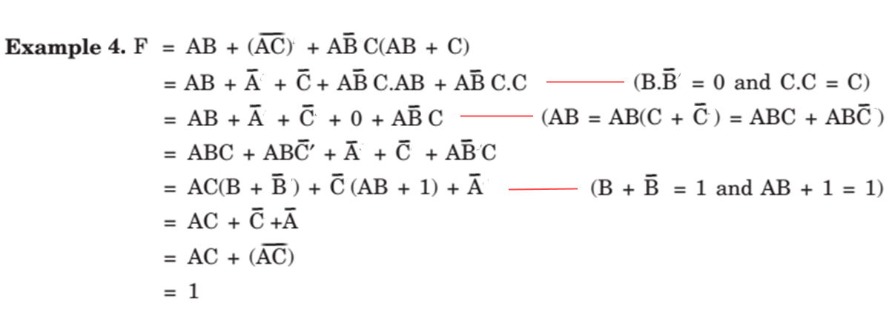

Slide 22
