Slide 1


ORGANISASI KOMPUTER
KAJIAN SISTEM DIGITAL
DISAIN SIRKUIT SEQUENTIAL
PRA-SEMESTER ORGANISASI KOMPUTER
TEKNIK INFORMATIKA SEM-IV
STT POMOSDA
2014

Slide 2
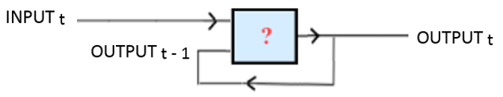




CIRCUIT DIGITAL SEQUENTIAL
Circuit yang bekerja berdasarkan DOMAIN WAKTU, sehingga memerlukan nilai awal OUTPUT (0 ataukah 1) .....
Digunakan untuk merakit cara mengendalikan circuit FLIP-FLOP

Slide 3
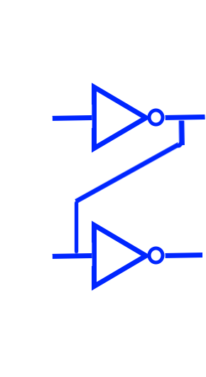


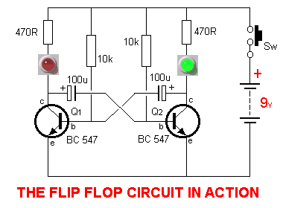
SIFAT FLIP-FLOP
0
1

Slide 4
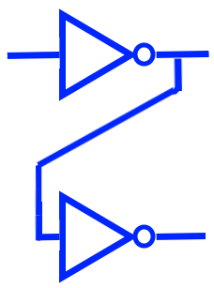
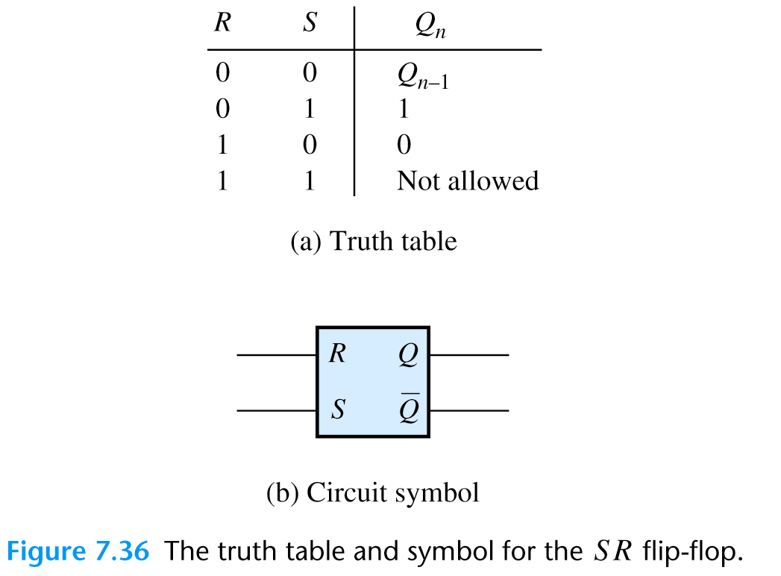
Merancang Filp-flop (FF)
FF Dasar
FF Lanjut
0
1
0
1
1
0
1
0
0
1
0
Harus bisa memilih disain gerbang logika atau kombinasinya yang bisa berperilaku FF.

Slide 5
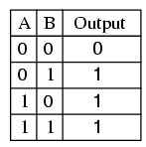
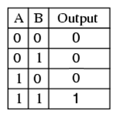
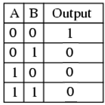
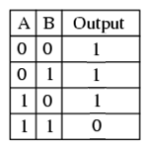
PERBANDINGAN TATBEL KEBENARAN
Jika ada INPUT 1
OUTPUT = 1
Jika ada INPUT 0
OUTPUT = 0
OR
AND
Jika ada INPUT 1
OUTPUT = 0
Jika ada INPUT 0
OUTPUT = 1
NOR
NAND

Slide 6


Tes Perilaku Disain Circuit Sequensial Setiap Gerbang Logik Dasar
GERBANG OR
GERBANG AND
input
ouput
input
ouput
t
t - 1
t
t
t - 1
t
0
0
0
1
1
1
1
0
1
0
1
0
0
1
1
1
0
0
1
1
1
0
0
0
0
1
1
1
0
0
1
1
1
0
0
0
Outputnya TIDAK berperilaku FF
Outputnya TIDAK berperilaku FF

Slide 7



Tes Perilaku Disain Circuit Sequensial Setiap Gerbang Logik Dasar
GERBANG NOR
GERBANG NAND
input
ouput
input
ouput
t
t - 1
t
t
t - 1
t
0
0
1
1
1
0
1
1
0
0
0
1
0
0
1
1
1
0
1
1
0
0
0
1
0
0
1
1
1
0
1
1
0
0
0
1

Slide 8
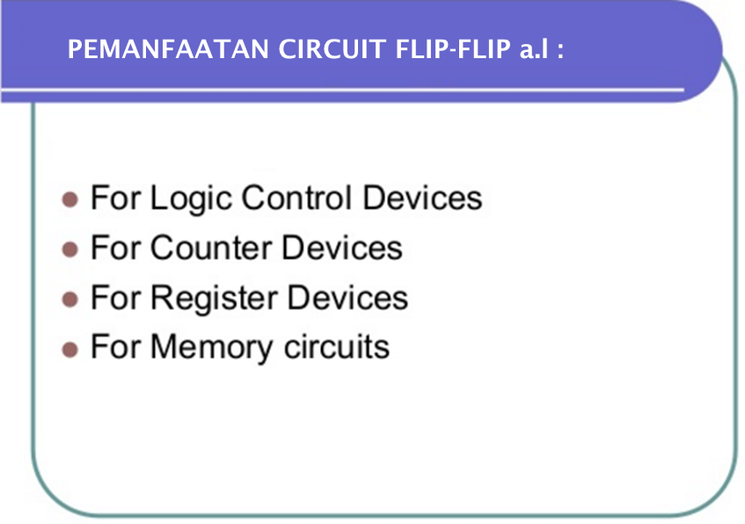

Slide 9
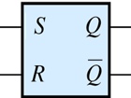
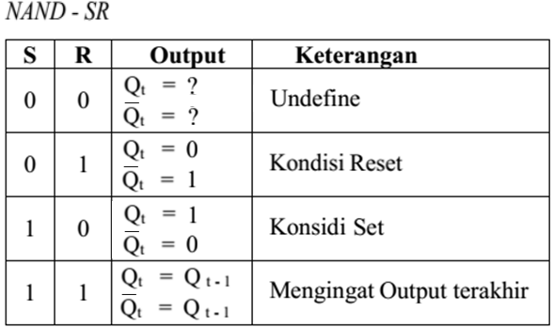
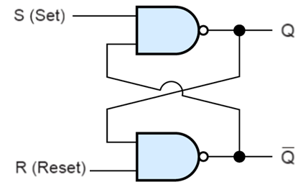
DISAIN SIRKUIT FF GERBANG NAND
SIMBOL FF NAND-SR

Slide 10
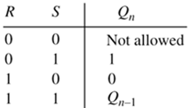
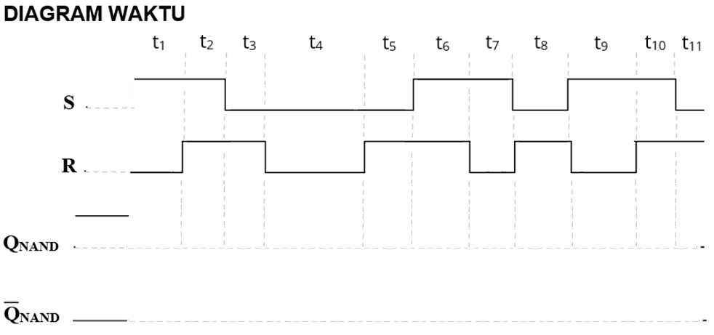
PERILAKU FF-NAND
memorize
undefine
memorize
memorize
undefine
memorize

Slide 11
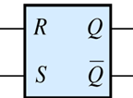
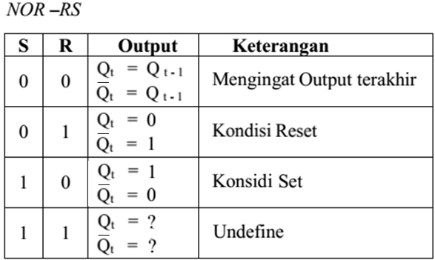
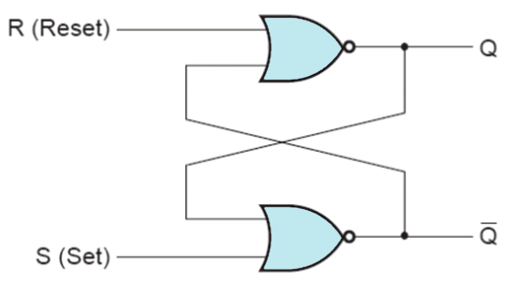
DISAIN SIRKUIT FF GERBANG NOR
SIMBOL FF NOR-RS

Slide 12
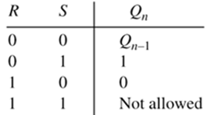
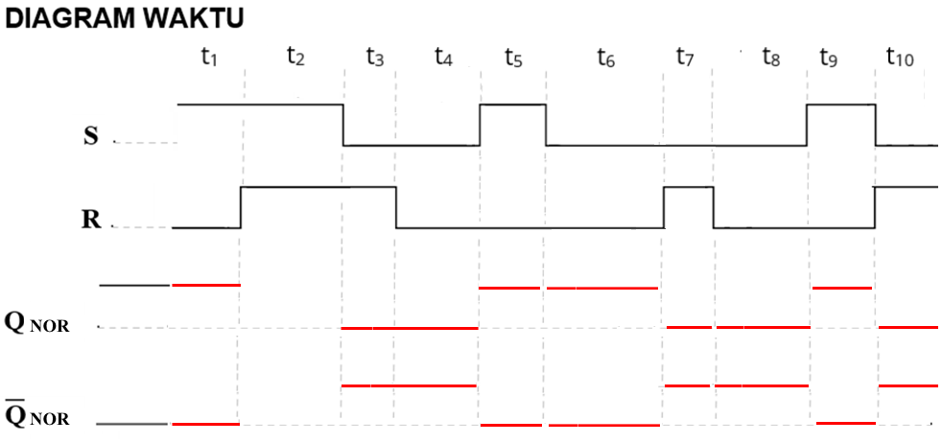
PERILAKU FF-NOR
undefine
memorize
memorize
memorize
undefine
memorize
memorize
memorize
undefine

Slide 13
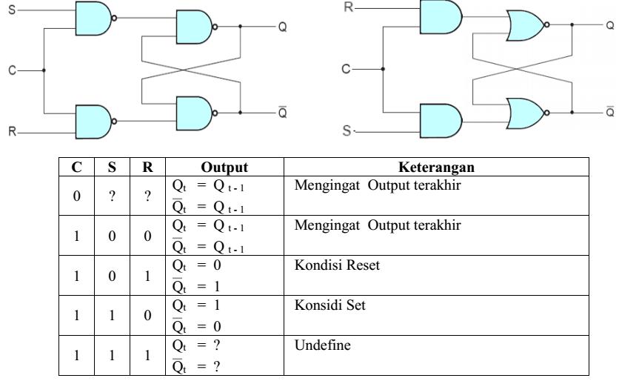
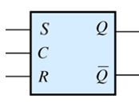
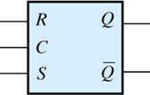
DISAIN SIRKUIT FF SINKRON DGN CLOCK
NAND
NOR

Slide 14
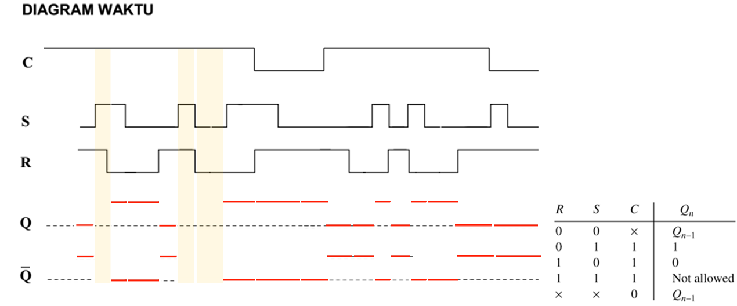
DISAIN SIRKUIT FF SINKRON DGN CLOCK
Undefine
Clock 0
Clock 0

Slide 15
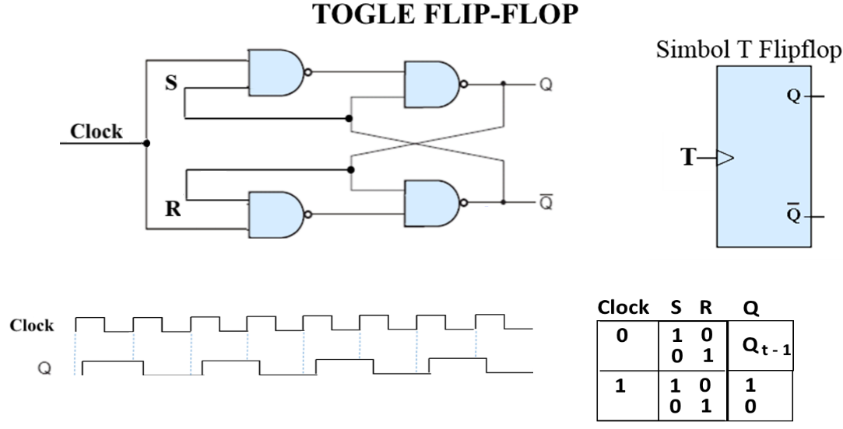

Slide 16

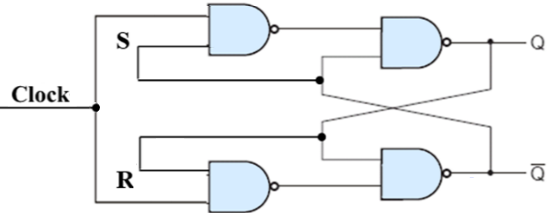
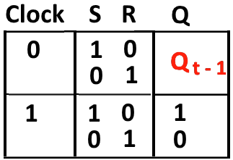
0
T-0

Slide 17
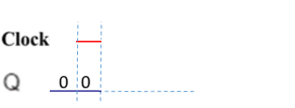
0
T-1
1
0
0
1

Slide 18
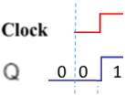
1
T-2
1
1
0

Slide 19

1
T-3
0
0
1
0

Slide 20

0
T-4
0
1
1
1

Slide 21

0
1
0
0
1

Slide 22

1
T-5
1
1
0
0

Slide 23

1
T-6
0
0
1
0

Slide 24

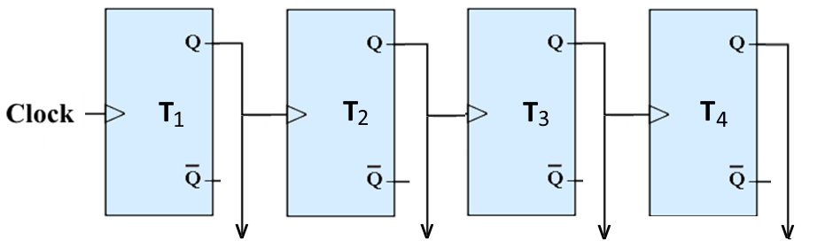
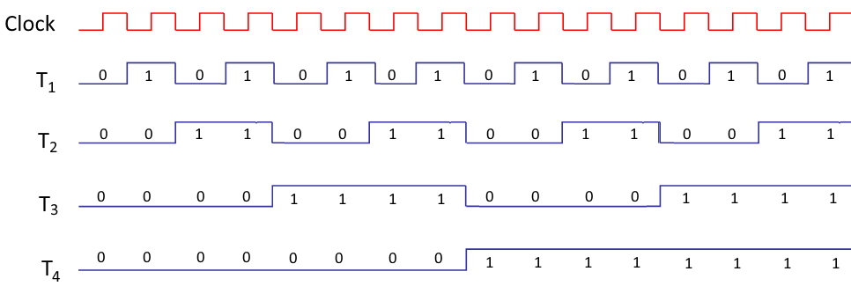

Slide 25
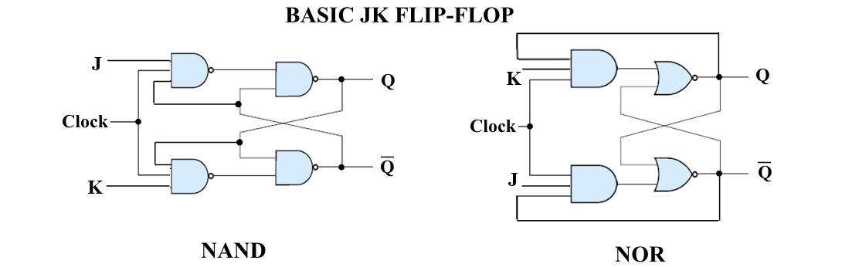
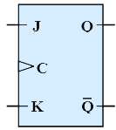
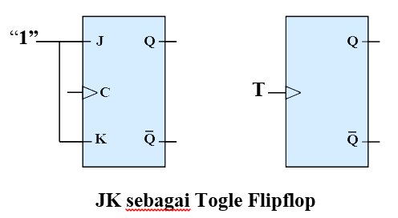

Slide 26
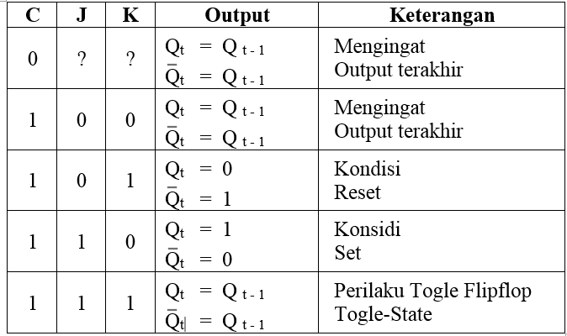

Slide 27
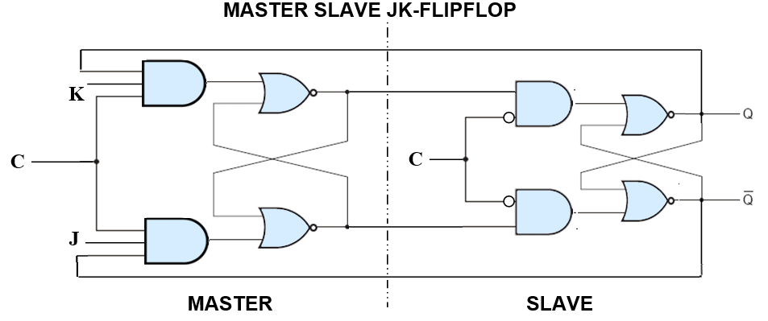
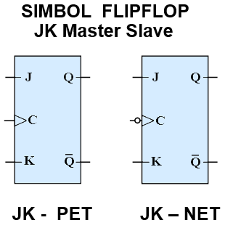

Slide 28
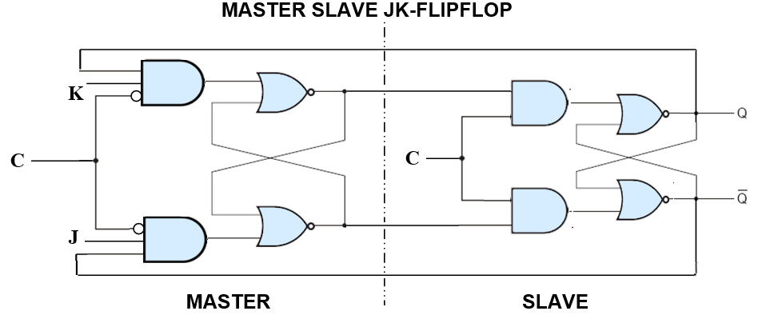

Slide 29
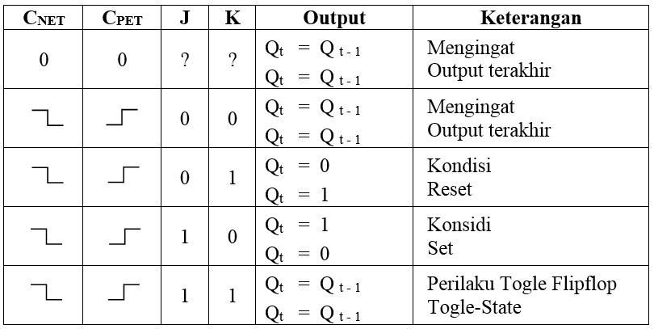

Slide 30
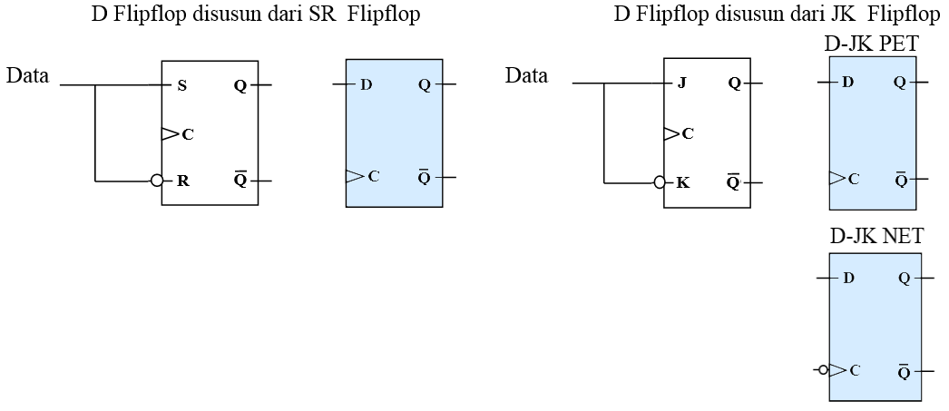
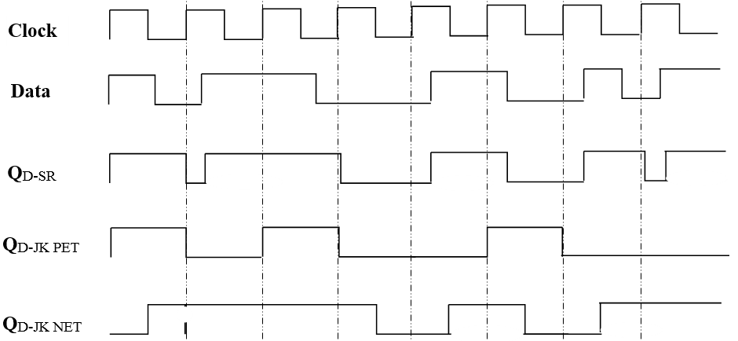
DATA FLIP-FLOP

Slide 31
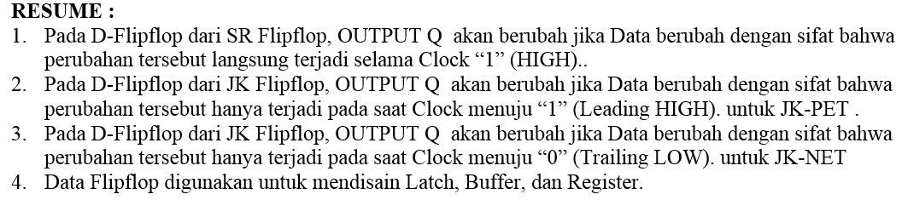

Slide 32
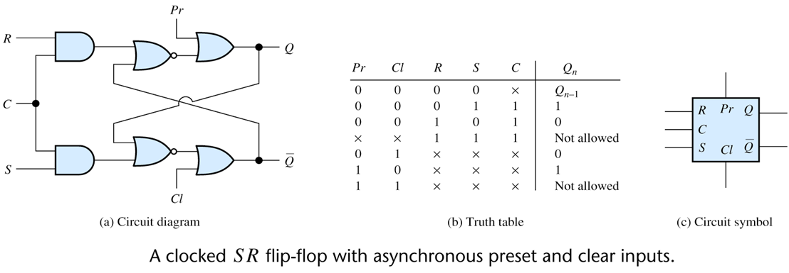
DISAIN SIRKUIT FF SINKRON DGN SETUP

Slide 33
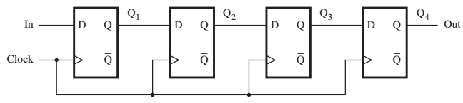
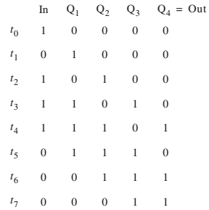
REGISTER DATA FLIP-FLOP
Serial BIT INPUT
Serial BIT OUTPUT
CLOCK SEBAGAI PEMICU BIT BERGESER KEKANAN

Slide 34
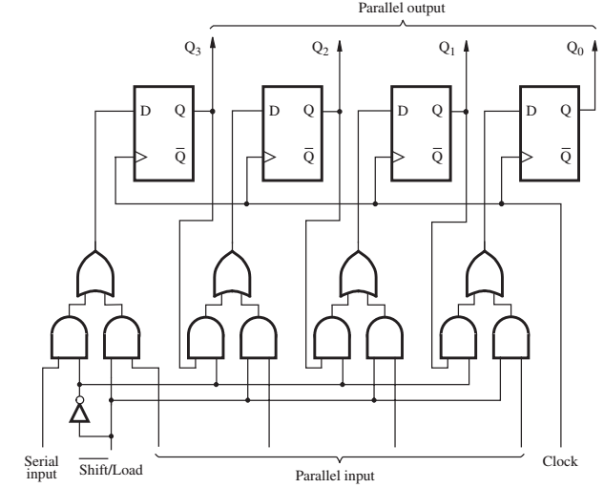
PARALEL IN – PARALEL OUT
SERIAL IN – PARALEL OUT

Slide 35
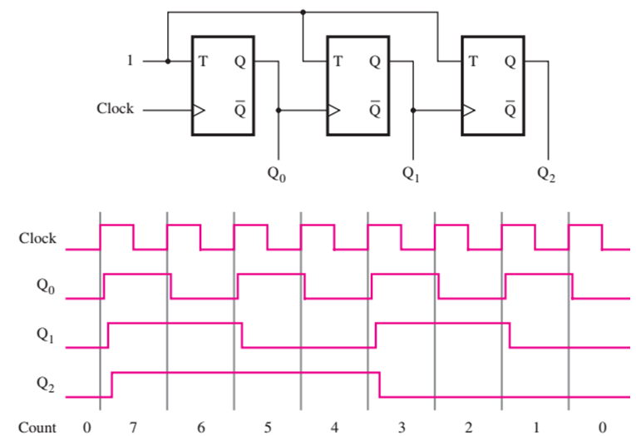
DOWN COUNTER – ASINKRON

Slide 36
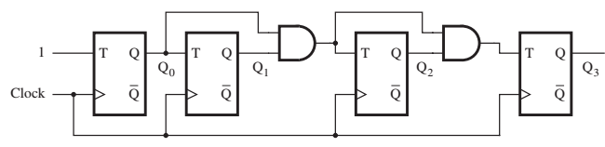
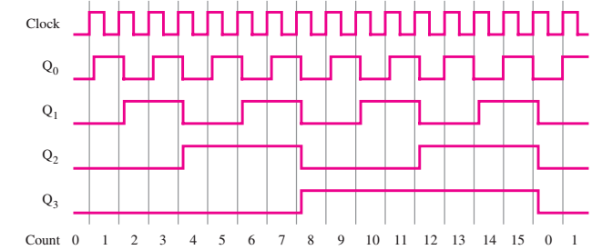
DOWN COUNTER – SINKRON

Slide 37
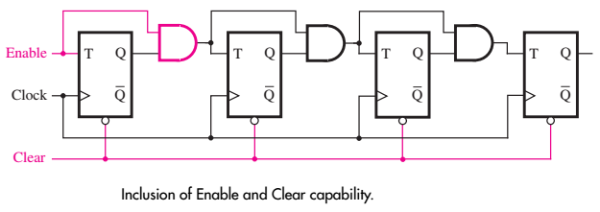
DOWN COUNTER – SINKRON MODIFIED
Jika Enable = 0, MAKA SEMUA OUTPUT 0

Slide 38


COUNTER - RING

Slide 39

COUNTER – Johnson Counter

Slide 40


Slide 41


COUNTER 4-BIT 16 CACAHAN
T0
T1
T2
T3
T4
T5
T6
T7
T8
T9
T10
T11
T12
T13
T14
T15

Slide 42
COUNTER 4-BIT 16 CACAHAN
T0
T1
T2
T3
T4
T5
T6
T7
T8
T9
T10
T11
T12
T13
T14
T15

Slide 43
COUNTER 4-BIT 16 CACAHAN
T0
T1
T2
T3
T4
T5
T6
T7
T8
T9
T10
T11
T12
T13
T14
T15

Slide 44
COUNTER 4-BIT 16 CACAHAN
T0
T1
T2
T3
T4
T5
T6
T7
T8
T9
T10
T11
T12
T13
T14
T15

Slide 45
COUNTER 4-BIT 16 CACAHAN
T0
T1
T2
T3
T4
T5
T6
T7
T8
T9
T10
T11
T12
T13
T14
T15

Slide 46
COUNTER 4-BIT 16 CACAHAN
T0
T1
T2
T3
T4
T5
T6
T7
T8
T9
T10
T11
T12
T13
T14
T15

Slide 47
COUNTER 4-BIT 16 CACAHAN
T0
T1
T2
T3
T4
T5
T6
T7
T8
T9
T10
T11
T12
T13
T14
T15

Slide 48
COUNTER 4-BIT 16 CACAHAN
T0
T1
T2
T3
T4
T5
T6
T7
T8
T9
T10
T11
T12
T13
T14
T15

Slide 49
COUNTER 4-BIT 16 CACAHAN
T0
T1
T2
T3
T4
T5
T6
T7
T8
T9
T10
T11
T12
T13
T14
T15

Slide 50
COUNTER 4-BIT 16 CACAHAN
T0
T1
T2
T3
T4
T5
T6
T7
T8
T9
T10
T11
T12
T13
T14
T15

Slide 51
COUNTER 4-BIT 16 CACAHAN
T0
T1
T2
T3
T4
T5
T6
T7
T8
T9
T10
T11
T12
T13
T14
T15

Slide 52
COUNTER 4-BIT 16 CACAHAN
T0
T1
T2
T3
T4
T5
T6
T7
T8
T9
T10
T11
T12
T13
T14
T15

Slide 53
COUNTER 4-BIT 16 CACAHAN
T0
T1
T2
T3
T4
T5
T6
T7
T8
T9
T10
T11
T12
T13
T14
T15

Slide 54
COUNTER 4-BIT 16 CACAHAN
T0
T1
T2
T3
T4
T5
T6
T7
T8
T9
T10
T11
T12
T13
T14
T15

Slide 55
COUNTER 4-BIT 16 CACAHAN
T0
T1
T2
T3
T4
T5
T6
T7
T8
T9
T10
T11
T12
T13
T14
T15

Slide 56
COUNTER 4-BIT 16 CACAHAN
T0
T1
T2
T3
T4
T5
T6
T7
T8
T9
T10
T11
T12
T13
T14
T15

Slide 57


Slide 58


COUNTER 4-BIT 10 CACAHAN (BCD)

Slide 59

COUNTER 4-BIT 10 CACAHAN (BCD)

Slide 60

COUNTER 4-BIT 10 CACAHAN (BCD)

Slide 61

COUNTER 4-BIT 10 CACAHAN (BCD)

Slide 62

COUNTER 4-BIT 6 CACAHAN

Slide 63

COUNTER 4-BIT 6 CACAHAN

Slide 64

APLIKASI COUNTER 4-BIT

Slide 65

APLIKASI COUNTER 4-BIT JAM DIGITAL

Slide 66

APLIKASI COUNTER 4-BIT JAM DIGITAL

Slide 67






Slide 68

IC CMOS AND GATE Layout

Slide 69

IC CMOS NAND GATE Layout

Slide 70


Slide 71


Slide 72


Slide 73


Slide 74


Slide 75


